Slide 1
Amazon sales data analysis Amazon is one of the leading E-commerce platform where users can buy million of products from a lot of categories.
-by Anshi Srivastava

Slide 2
Objectives
To find which is bestseller item type.
To find which order priority gave the highest sales.
To fond yearly total sales.
To find total sales and total
profits in the regions.
- To calculate total sales , total profits , average profit margin and average unit price.
-by Anshi Srivastava

Slide 3

The process - Data collection - Data cleaning - Data Visualization - Insights - Summary
-by Anshi Srivastava

Slide 4

Data collection
The data has been collected in the form of a csv file named “AMAZON SALES ANALYSIS” .
THE CSV FILE HAS THE DATA OF SALES OF PRODUCTS DURING THE TIMESPAN OF 2010 AND 2017
-by Anshi Srivastava

Slide 5
DATA CLEANING
There were no Null values or blank fields
Some values in ‘Order Date’ and ‘Ship date’ columns are in string datatype. So we converted them to datetime datatype using python.
Most of the values in ‘Total revenue’ , ‘Total cost’ and ‘Total Profit’ columns are written with two decimal places , so we make sure that each value in these columns have two decimal places by using excel.
-by Anshi Srivastava

Slide 6
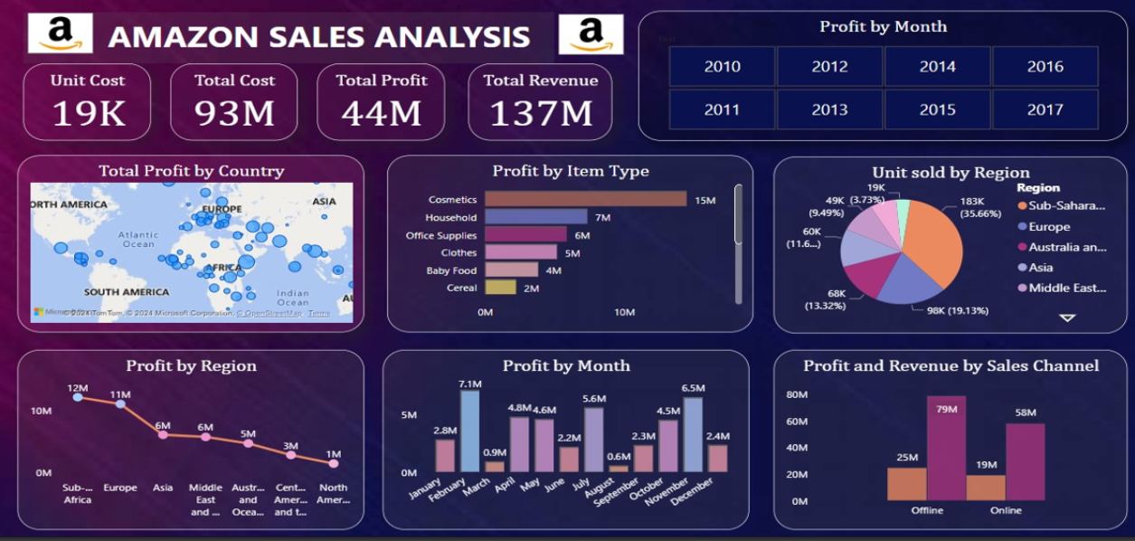
Data visualization
-by Anshi Srivastava

Slide 7
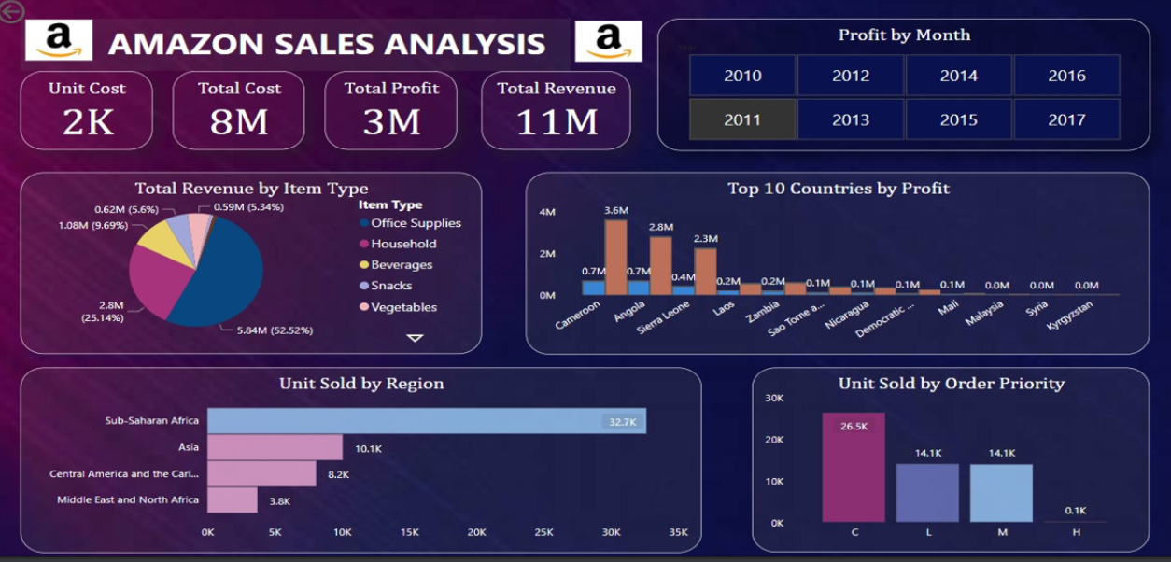
Data Visualization
-by Anshi Srivastava

Slide 8
Insights
• The total sales is $137.35 million out of which total profit is $44.17 million.
• The average profit margin and unit price is $32.16 and $276.76 respectively.
• The "H" order priority gave the highest sales, which means people need their products fast.
• "Cosmetics" products gave the highest sales.
• Majority of people still prefer "Offline Channel" for buying products .
-The year 2012 has seen the highest sales
• The Sub-Saharan Africa region has seen the highest sales.
-by Anshi Srivastava

Slide 9

Summary
Cosmetic products are very popular among people of Europe and these products generated the highest profit ($14.56 million) of all items. So, it is advisable to create some marketing campaigns promoting Cosmetic products.
Total Population of North America prefer to shop offline as compared to people of Europe, who mostly prefer Online channel for shopping. But because high profits are coming from Online channel, it advisable to promote products online.
The Region Sub-Saharan Africa has generated the highest profit where people bought Fruits the most, with approx. 31 thousands unit sold. Highlight the health benefits of fruits during campaigns and align marketing with local preferences.
The second most purchased item, after Cosmetics in Europe is Baby Food. This insight tells us that majority of people of Europe are newlywed couples. Thus you can promote products related to new born babies to these people.
-by Anshi Srivastava

Slide 10
thank you for your attention
-by Anshi Srivastava

